Slide 2
MAN-10081 Teams, People and Performance
M

Slide 3
LECTURE 1 - MODULE INTRODUCTION AND WELCOME - 26 January 2026

Slide 4
Session Content
Introductions
Module outline and delivery
Introduction to Teams
Team Formation and Roles

Slide 5
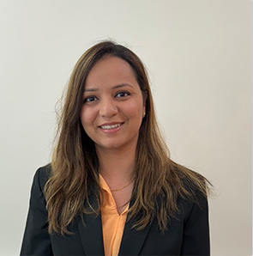
Introductions
Teaching Team
Module Leader:
Dr Swati Garg
Office Keele Smart Innovation Hub 1.039
Email: s.garg@keele.ac.uk
Office Hours
Tuesday 12-2 pm
Wednesday Online 12-1 pm

Slide 6
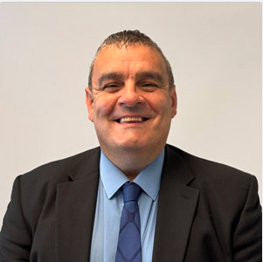
Introductions
Dr Scott Bambrick
Director of Keele Business School
Office Keele Smart Innovation Hub
Email: s.bambrick@keele.ac.uk

Slide 7
Teams, People and Performance -
Module Aims
The aim of this module is to provide students with an understanding of the principles and practices that underpin effective teamwork and team performance. Students will explore the roles and dynamics within teams, recognising how individual contributions and leadership impact collective outcomes. The module seeks to develop students’ abilities to identify and apply key team theories and practices in real-world scenarios. Through engaging activities and assessments, students will gain insights into team development, communication, and performance management, equipping them with the foundational skills needed to effectively collaborate and contribute within diverse organisational settings.

Slide 8
Assessment Summary
Students are required to produce either a 5–10-minute podcast or a 1500-word written report. This project is a deep reflection on your experiences during the team-based exercises in this module, including collaborative tasks, leadership activities, and problem-solving challenges. The submission must address the following three areas:
Individual role in the team
Team dynamics
Personal development
Submission deadline: 11 May 2026, 1 pm, via KLE

Slide 9
Creating and Forming Teams Dr Scott Bambrick

Slide 10
Group Dynamics
What is a team?
Tuckman’s – Forming – Norming – Storming –Performing
Belbin’s Team Roles

Slide 11
A team is – a group plus a GOAL and a PLAN to reach it
“A team is a small number of people with complementary skills who are committed to a common purpose, set of performance goals, and approach for which they hold themselves mutually accountable. “
Katzenbach and Smith, The Wisdom of Teams (1993)

Slide 12
Team Life Cycle Model
Forming
Storming
Norming
Performing
Adjourning / Mourning
Tuckman and Jensen, 1977

Slide 13
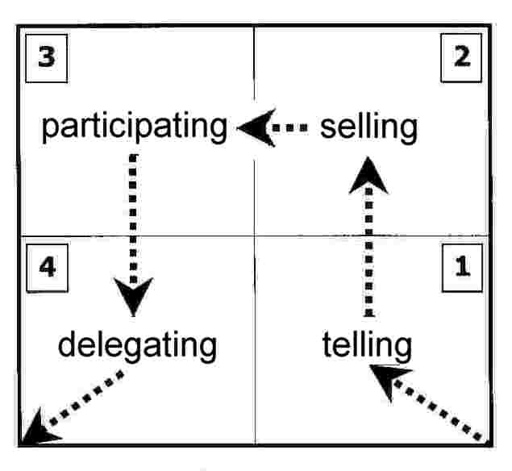
Notes:
Hersey and Blanchard characterized leadership style in terms of the amount of task behavior and relationship behavior that the leader provides to their followers. They categorized all leadership styles into four behavior types, which they named S1 to S4:
S1: Telling – is characterized by one-way communication in which the leader defines the roles of the individual or group and provides the what, how, when, and where to do the task
S2: Selling – while the leader is still providing the direction, he or she is now using two-way communication and providing the socioemotional support that will allow the individual or group being influenced to buy into the process.
S3: Participating – this is now shared decision making about aspects of how the task is accomplished and the leader is providing less task behaviors while maintaining high relationship behavior.
S4: Delegating – the leaders is still involved in decisions; however, the process and responsibility has been passed to the individual or group. The leader stays involved to monitor progress.
Of these, no one style is considered optimal for all leaders to use all the time. Effective leaders need to be flexible, and must adapt themselves according to the situation.

Slide 14
Team Formation
Recruit team members
Allocated members
Existing staff
Other organisations’ representatives

Slide 15
Team Formation
Qualities - experience / ability / personality / work ethic
Recruit expertise / skills for the project (general / specific)
If not available – have to buy in or learn (to do job)
Virtual team – in house and external partners

Slide 16
Team Processes
Time to establish roles and ‘work out’ positions
May be period of conflict / personality clashes – manage or allow to resolve
Set agenda for team
Rules – formal / informal (socialisation) for team
Set inside team / by organisation

Slide 17
Team Processes
Establish method of working (set ‘rules’ / organise)
Allocate project roles and work (standards / timescales)
Setup support / allocate training (formal / informal)
Courses / mentoring / in-house / external / personal / Computer-based training

Slide 18
Charter/Rule/Parameters
Can have formal / informal team charter
Set out purpose of the team
Roles / responsibilities
Define workloads

Slide 19
Charter/Rule/Parameters
Set ‘norms’ – rules (formal / informal)
Induction training / qualifications (to be team members)
Socialisation process (meetings, lunch, dress code, language)

Slide 20
Management/Team Leaders
Set objectives for team
Set timescales and standards
Setup mechanisms to measure both
Determine how performance will be measured (and how often)
Setup feedback mechanisms (team meetings / reports / briefings / cascading information / emails / notice board)

Slide 21
Management
Style of management (aggressive / passive – coerce / collaborate)
Formal mechanisms – meetings / briefings / paper or email reports / agenda and minutes
Informal – chat / lunch
Environment – office interview / meeting rooms / web tele conference / restaurant / water-cooler
Depends on style and degree of formality needed

Slide 22
Management Control
Prescriptive to ‘leave alone’
Authoritarian to self-directed
Need to allocate project work
Set specific rules for performing (style - directed / autonomous / time limits / standards)
Set brief for work (scope of tasks)
Team style – can be different to project work ‘rules’

Slide 23
Management Control
Method of working – collaborative / individual
Report to leader / group
Manage in interventionist / self directing way (or combination – depending on tasks)
Apply - direct supervision / mentor / facilitate
People centred / task centred emphasis in leading the team

Slide 24
Team Composition
Need mix of different roles (Belbin)
Could be same person / people
Problem solvers
Task completers
Team managers
May have to recruit experts
Important that team ‘blend’ is correct and managed – to perform project

Slide 25
Problematic Team Members
Obtain information and check / detect problem
Decide on method to address (consult if necessary)
Can be formal or informal discussion
Try to change their behaviour then monitor and feedback
Go to bosses (or their bosses) to make formal complaint

Slide 26
Problematic Team Members
Try to have them removed from the team
Change their work – perhaps better suit them
Reduce their project involvement (remove work – give to someone else)
Reduce their involvement with the team (if they are causing disruption / problems)

Slide 27
Influence of the Team Leader
Range of tactics from coercion to collaboration
To try to get project work done on time and to standard
Can adjust work mix to try to get result
Can change project (reduce scope / do different project)
Can stop project – if failing and using resources
Degree of influence – direct / high for own job and team to indirect / low at Global level

Slide 28
Every team task has a hidden challenge
It always involves not one but TWO tasks
The task itself
PLUS the larger and more difficult task of looking after the team and keeping it together in order to achieve the task
Some say it is 1/3 task and 2/3 team
As a student so far, you are used to doing tasks yourself BUT
Being able to handle the team dimension is a vital step towards becoming a professional and being a MANAGER

Slide 29
Belbin’s TEAM ROLES
Members have dual roles: job and team usually selected on basis of job role
Team roles based on four principal factors
intelligence
dominance
extroversion
stability/anxiety
Notes:
07/16/96
##
*
*
Dr Meredith Belbin conducted research over several years into the working of teams and the roles of team members. He found that
in general team members have dual roles: their job role (e.g. accountant, in team because of financial expertise) and their team role - which is the fct they perform in the team
one of the things that makes team working more complex than it might appear on the surface is that team members are usually selected for a team on the basis of their job role - specialist expertise, skill, knowledge or representation they bring - but their team role (often unspoken and unidentified) affects the successful working of the team
what are these team roles? Belbin found they were based on these four principal factors: intelligence, dominance, extroversion, stability
each of the different team roles he identified has these four principal factors in greater or lesser degree. His research characterised the nine different team roles according to these factors, and according to the way in which they behaved in their team role.

Slide 30
Belbin’s Team Roles
Plant
Resource Investigator
Co-ordinator
Monitor Evaluator
Implementer
Shaper
Completer/Finisher
Team worker
Specialist
Plant

Slide 31
The Nine Team Roles! Plant:
Strengths:
Creative, imaginative, unorthodox.
Solves difficult problems
Allowable weaknesses:
ignores details, too pre-occupied to communicate effectively

Slide 32
Resource Investigator:
Strengths:
Extrovert, enthusiastic, communicative.
Explores opportunities; develops contacts
Allowable weaknesses:
Over optimistic.
Loses interest once initial enthusiasm has passed

Slide 33
Co-ordinator:
Strengths:
Mature, confident, a good chair-person.
Clarifies goals, promotes decision making, delegates well
Allowable weaknesses:
Can be seen as manipulative. Delegates personal work

Slide 34
Shaper:
Strengths:
Challenging, dynamic, thrives on pressure.
Has the drive and courage to overcome obstacles
Allowable weaknesses:
Can provoke others.
Tends to hurt people’s
feelings

Slide 35
Monitor Evaluator:
Strengths:
Sober, strategic and discerning.
Sees all options.
Judges accurately
Allowable weaknesses:
Lacks drive and ability
to inspire others.
Overly critical

Slide 36
Team worker:
Strengths:
Co-operative, mild, perceptive and diplomatic.
Listens, builds, averts friction, calms the waters
Allowable weaknesses:
Indecisive in crunch
situations.
Can be easily influenced

Slide 37
Implementer:
Strengths:
Disciplined, reliable, conservative and efficient.
Turns ideas into practical actions
Allowable weaknesses:
Somewhat inflexible.
Slow to respond to new
possibilities

Slide 38
Completer/finisher:
Strengths:
Painstakingly conscientious, anxious.
Searches out errors and omissions.
Delivers on time
Allowable weaknesses:
Inclined to worry unduly.
Reluctant to delegate.
Can be a nit-picker

Slide 39
Specialist:
Strengths:
Single-minded, self-starting, dedicated.
Provides knowledge and skills in short supply
Allowable weaknesses:
Contributes on only a narrow front
Dwells on technicalities
Overlooks the ‘big picture’.

Slide 40
The best mix?
Belbin found that a group seems to work well if there is:
a Co-ordinator
A good Plant with the right creative skills
A monitor-evaluator
A spread of other types – crucially an implementer or completer-finisher
A mix of extrovert/introvert, ideas/assessor, change/continuity is important.
What roles do you think you have in your team?

Slide 41
SOME HANDY HINTS
Someone take notes and distribute to group
Set out ground rules for the group
Set out meeting times
Set targets for individuals

Slide 42
References and Further Reading
Buchanan, D. and Huczynski, A. (2019) Organisational Behaviour, 10th edition, Harlow: Pearson Education, Limited.
Mullins, L. J. and McLean, J. E. (2019) Organisational behaviour in the workplace, 12th edition, Harlow: Pearson.
Belbin Team Roles | Belbin

